Slide 1
Socket Programming

Slide 2
What is Socket ?
It is an abstraction that is provided to an application programmer to send or receive data to another process.
Data can be sent to or received from another process running on the same machine or a different machine.
It is like an endpoint of a connection

Slide 3
What is Socket ?
A socket is one end-point of a two-way communication link between two programs running on the network.
A socket is a Java object which has methods to connect, accept connections and transfer data.

Slide 4
Java Network Programming
Network programming in Java in general much easier than in other languages.
Socket classes are used to represent the connection between a client program and a server program.

Slide 5
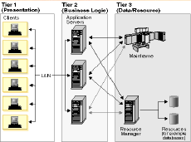
Client Server Architecture

Slide 6
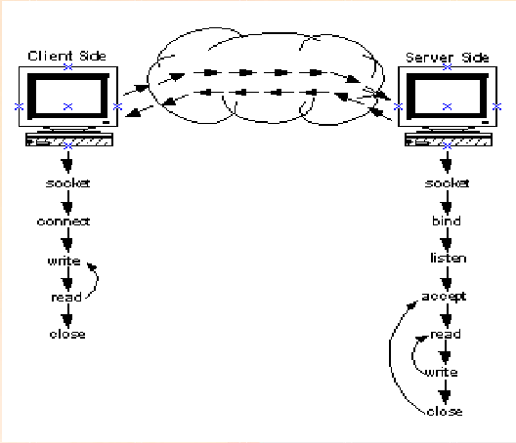
Client Server Architecture

Slide 7
Java Sockets
Java supports both TCP and UDP sockets.
Part of the java.net package
  import java.net.*;
Provides two classes of sockets for TCP
  Socket – client side of socket
  ServerSocket – server side of socket

Slide 8
Java Sockets
Provides one socket type for UDP
  DatagramSocket

Slide 9
Java TCP Sockets
ServerSocket
  ServerSocket performs functions bind and listen
    Bind – fix to a certain port number
    Listen – wait for incoming requests on the port
Socket
  Socket performs function connect
    Connect – begin TCP session

Slide 10
Types of Connection
Single Connection Server
  Open a server socket
  Accept the connection and wait
  Communicate
  Accept
  Close the connection when done

Slide 11
Types of Connection
Multiple Connection Server
  Open a server socket
  Accept connection and wait
  Start Thread to communicate
  Accept connection and wait
  Close connection when done

Slide 12
TCP Client-Server
TCP Client Socket
  Actively connects to a waiting server socket
  Java.net.Socket class
  Connections are bi-directional.
  Each direction of the connection is usually handled by its own thread.

Slide 13
TCP Client-Server
TCP Server Socket
  Create an instance of java.net.ServerSocket
  Accept connection
  Communicate on the connection.

Slide 14
Server Example

